Slide 1

AASD 4004
Machine Learning - II
Applied AI Solutions Developer Program

Slide 2
Module 06 Recommenders
Vejey Gandyer

Slide 3
Agenda
Recommenders
Why Recommenders?
Ways of recommending
How Recommenders work?
Types of Recommenders
Evaluation of Recommenders

Slide 4
Recommenders
What is it?

Slide 5
Recommenders
A recommender filters the data using different algorithms and recommends the most relevant items to users
Captures the past behaviour of a customer (Data collection) and based on that, recommends products which the users might be likely to buy

Slide 6
Why

Slide 7
Why Recommenders?
To create an amazing user experience
To increase product sales by recommending similar or complementary products to the user
To add additional ad stream revenue by recommending specific products

Slide 8
Ways of recommending

Slide 9
Ways of recommending
Recommend items to a user which are most popular among all the users
Drawback: Every user will see the same recommendations
Divide the users into multiple segments based on their preferences (user features) and recommend items to them based on the segment they belong to
Drawback: More computation time as number of users increases
Cold Start Problem

Slide 10
How Recommenders work?

Slide 11
How Recommenders work?
Data is collected from users (Onboarding)
Models are created from the collected data (Algorithms)
Recommendations are pushed to the user (Action)
Recommendation Engine = Call-to-Action push from recommendation models trained by user collected data

Slide 12
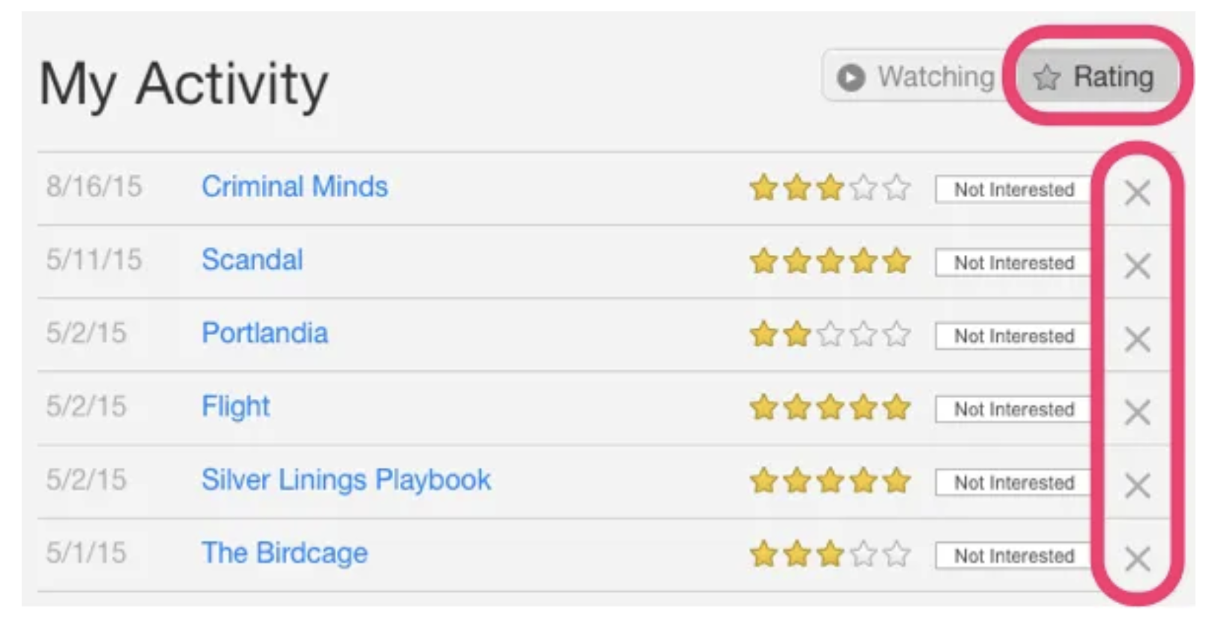
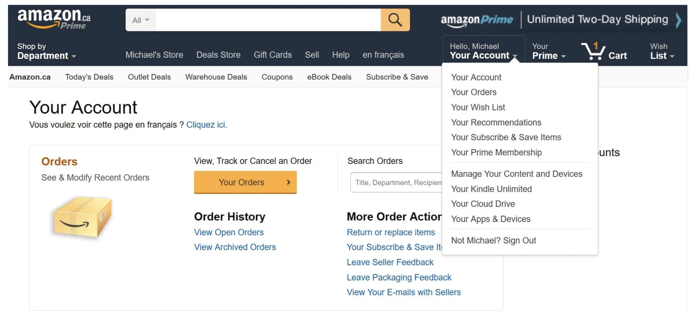
Data Collection (Onboarding)
Explicit
Data provided by users explicitly in the way of Product Ratings, Rankings, Likes, and so on.
Implicit
Data not provided by users explicitly but collected through user's behaviour with the product in the way of Clickstream, Search History, Order History, Website Navigation, Analytics and so on

Slide 13
Types of Recommenders

Slide 14
Types of Recommenders
Content Filtering
Collaborative Filtering
Hybrid

Slide 15
Types of Recommenders
Content Filtering

Slide 16
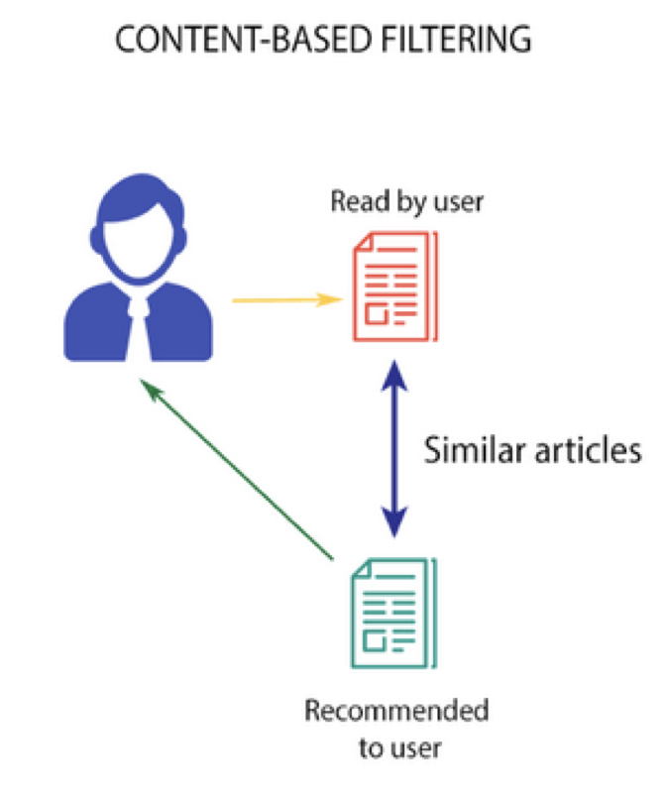
Content-based Filtering
Movie recommendation
If a person likes “Inception”, then algorithm will recommend movies that fall under the same genre
How does the algorithm know “genre”
Profile Vector - Users past behaviour (movies liked/disliked, ratings)
Item Vector - movies (genre, cast, director, music, etc)

Slide 17
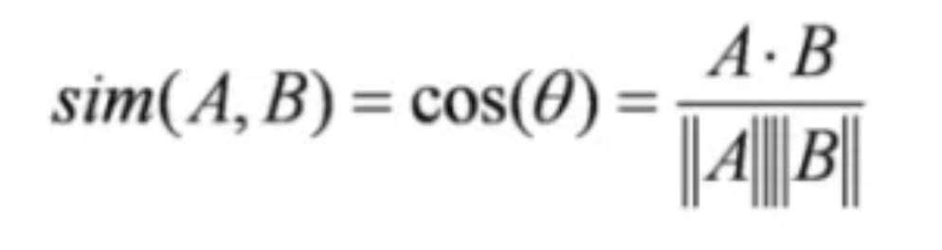
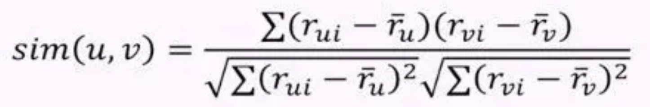
Content-based Filtering
How recommendations are computed?
Similarity measured using one of the distances
Cosine similarity
Euclidean similarity
Pearsons Correlation

Slide 18
Content-based Filtering
Top n
Movies are sorted with respect to similarity and top n movies are recommended
Rating scale
Threshold is set and all the movies above threshold are recommended
Drawbacks:
Movies of same genre are recommended
Movies of different genres are not recommended

Slide 19
Types of Recommenders
Collaborative Filtering

Slide 20
Collaborative Filtering
Algorithm uses user behaviour for recommending items
User-User Collaborative filtering
Item-Item Collaborative filtering

Slide 21
Types of Recommenders
User-User Collaborative Filtering

Slide 22
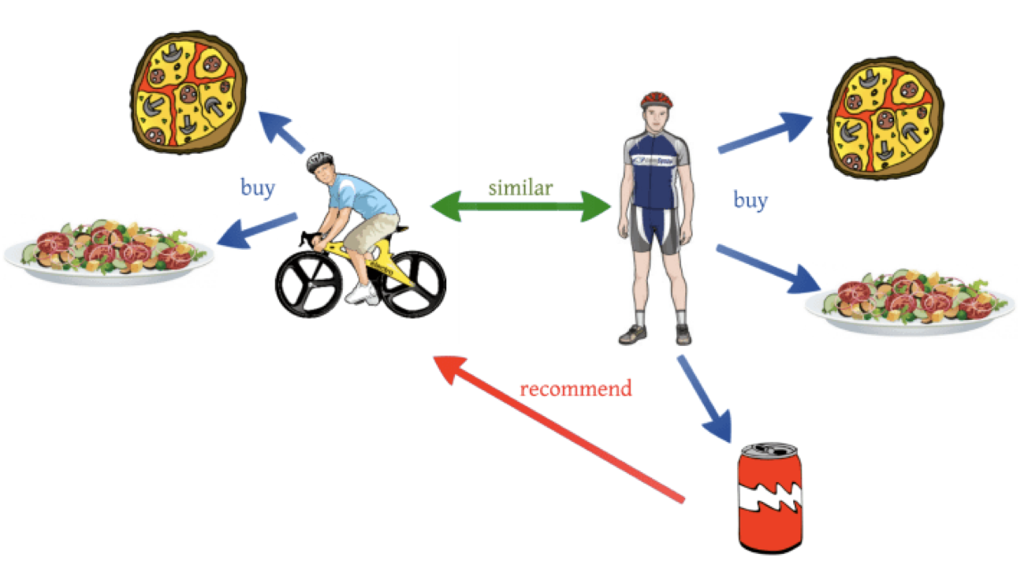
User-User Collaborative Filtering
Finds Similarity score between users
For a user, pick the most similar users
Recommend the items which these most similar users bought/liked/rated previously

Slide 23
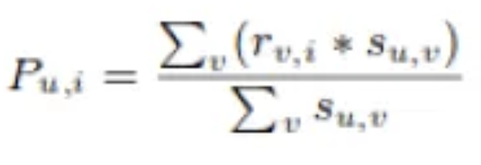
User-User Collaborative Filtering
Use Pearson correlation to find similarity between the user u and v.
First we find the items rated by both the users and based on the ratings, correlation between the users is calculated.
The predictions can be calculated using the similarity values. This algorithm, first of all calculates the similarity between each user and then based on each similarity calculates the predictions. Users having higher correlation will tend to be similar.
Based on these prediction values, recommendations are made

Slide 24
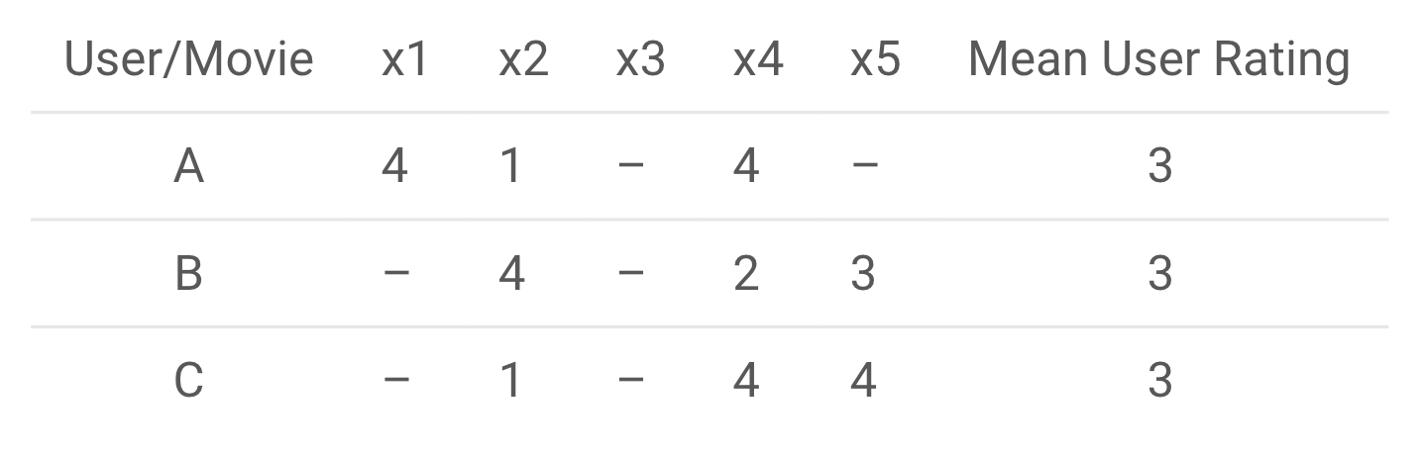
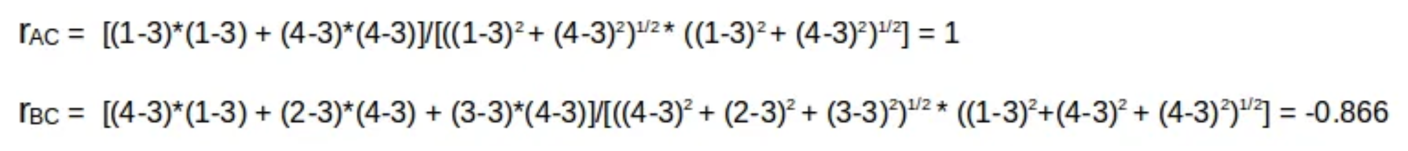
User-User Collaborative Filtering

Slide 25
User-User Collaborative Filtering
Drawbacks:
Time consuming
Calculates similarity for each user and then calculates prediction for each similarity score
Solution: (Select few users instead of all)
Select a threshold similarity and choose all users above that value
Randomly select the users
Arrange neighbours in descending order of their similarity value and choose top-N users
Use clustering for choosing neighbours

Slide 26
Types of Recommenders
Item-ItemCollaborative Filtering

Slide 27
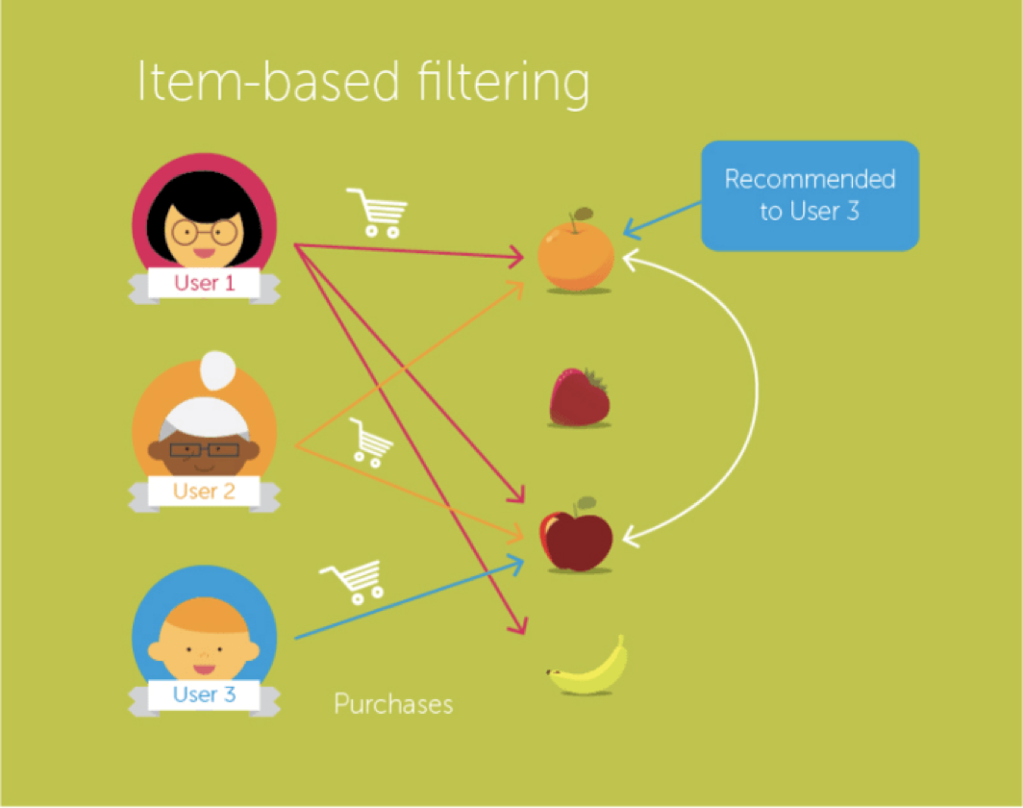
Item-Item Collaborative Filtering
Finds Similarity score between items
For an item, pick the most paired items
Recommend the items which these most similar users bought/liked/rated previously

Slide 28
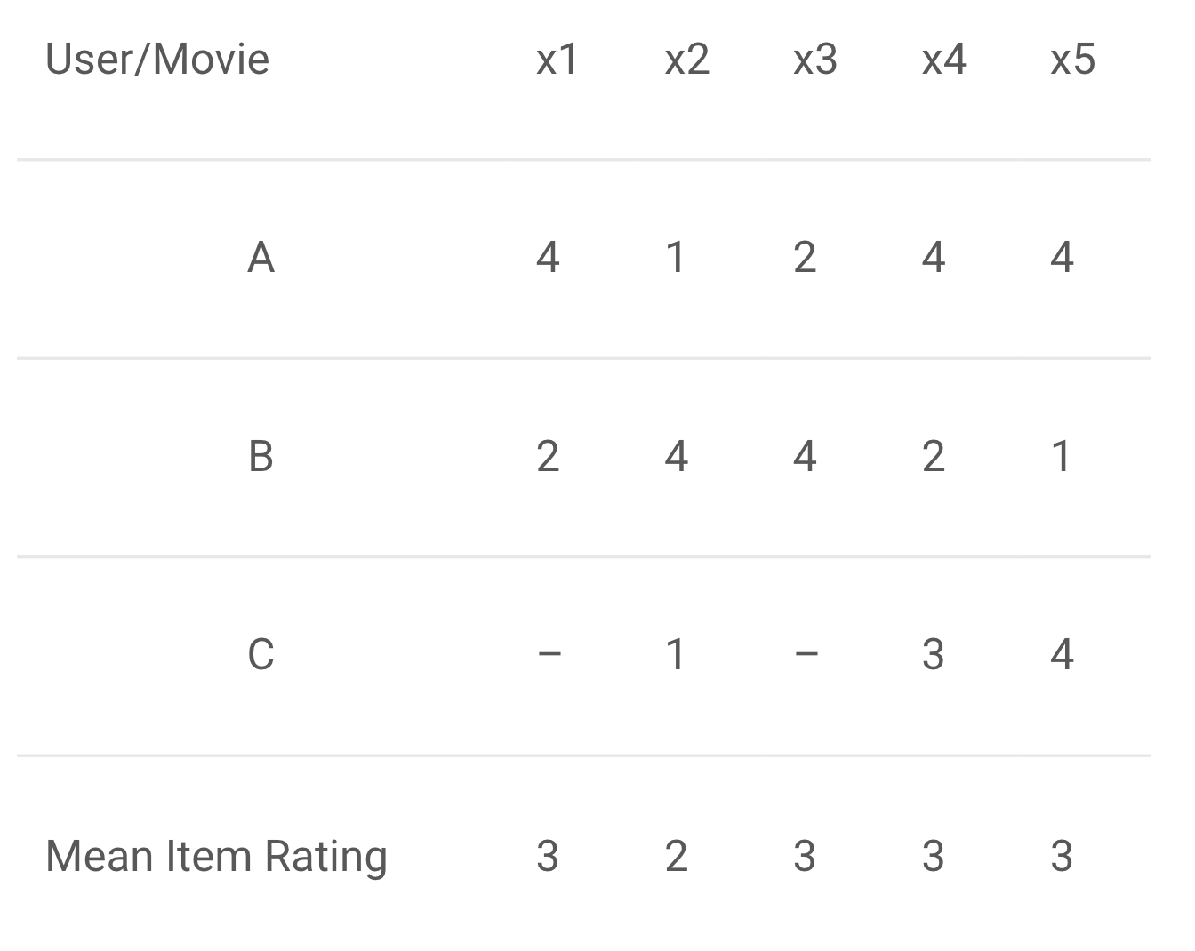
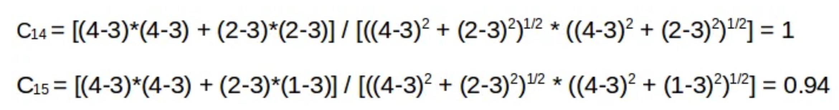
Item-Item Collaborative Filtering

Slide 29
Item-Item Collaborative Filtering
What will happen if a new item or a new user comes into the recommendation ecosystem?
No data of that item or user exists
No recommendations possible (Cold Start problem)
Visitor Cold Start - a new user
Solution: Popularity recommender - Recommend most popular products to the new user
Product Cold Start - a new item
Solution: Content-based filtering - Use content of the new product to recommend

Slide 30
Movie Recommender
https://grouplens.org/datasets/movielens/100k/

Slide 31
Matrix Factorization Recommender

Slide 32
Matrix Factorization Recommender
Problem:
Not every movie is rated by every user. Find a set of features which can define how a user rates the movies. These are called latent features.
We need to find a way to extract the most important latent features from the existing features.
Solution:
Matrix factorization is a technique which uses the lower dimension dense matrix and helps in extracting the important latent features.

Slide 33
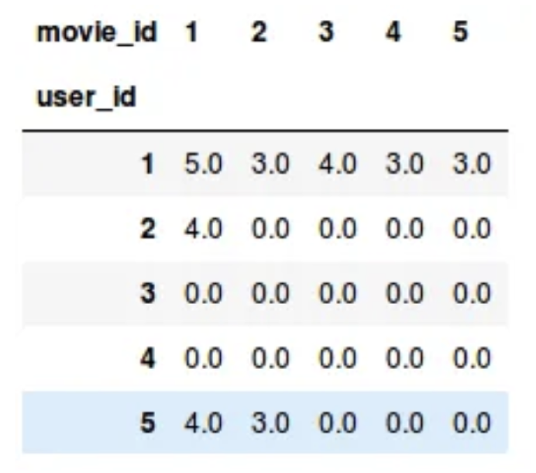
Matrix Factorization Recommender
User-Item matrix
user_id : every user
movie_id : every item
5.0 - 1.0 (Highly liked - Least liked)
0.0 - Movie not rated by the user

Slide 34
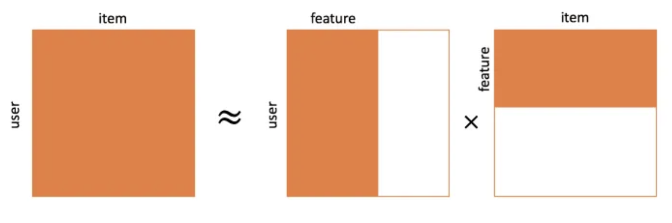
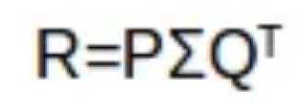
Matrix Factorization Recommender
M is the total number of users
N is the total number of movies
K is the total latent features
R is MxN user-movie rating matrix
P is MxK user-feature affinity matrix which represents association between users and features
Q is NxK item-feature relevance matrix which represents association between movies and features
Σ is KxK diagonal feature weight matrix which represents the essential weights of features

Slide 35
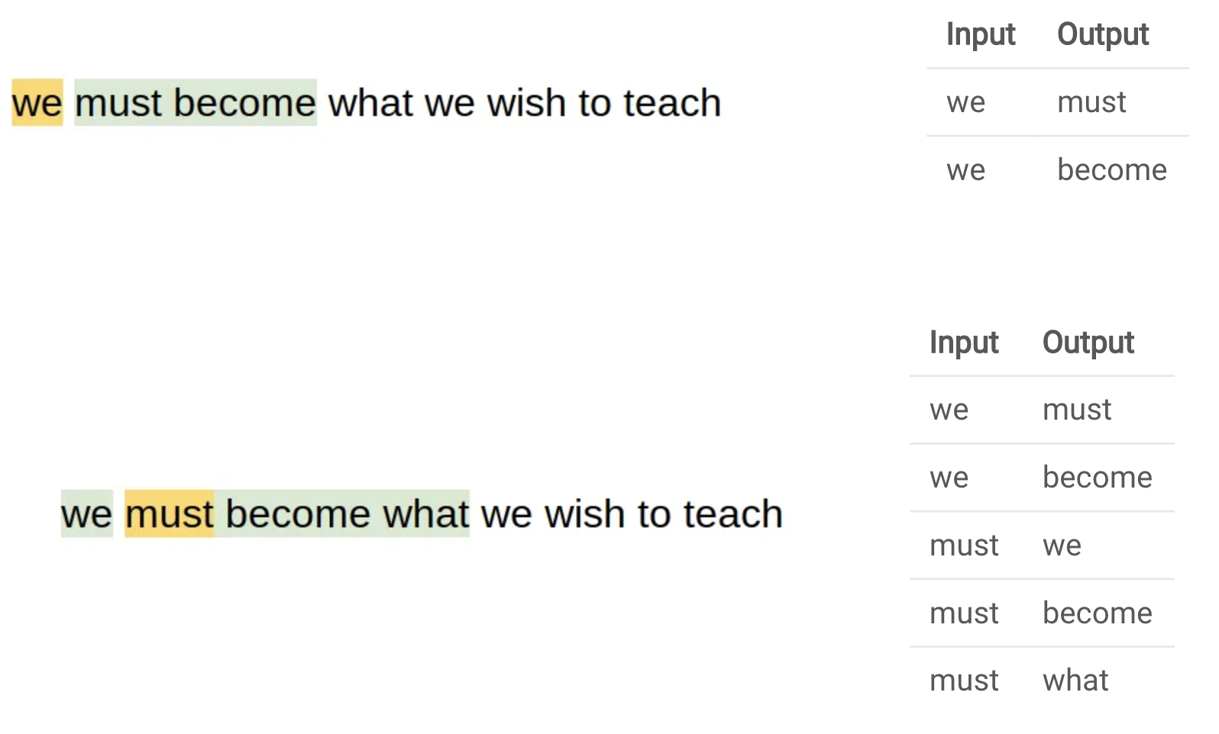
Word2Vec Revisited

Slide 36
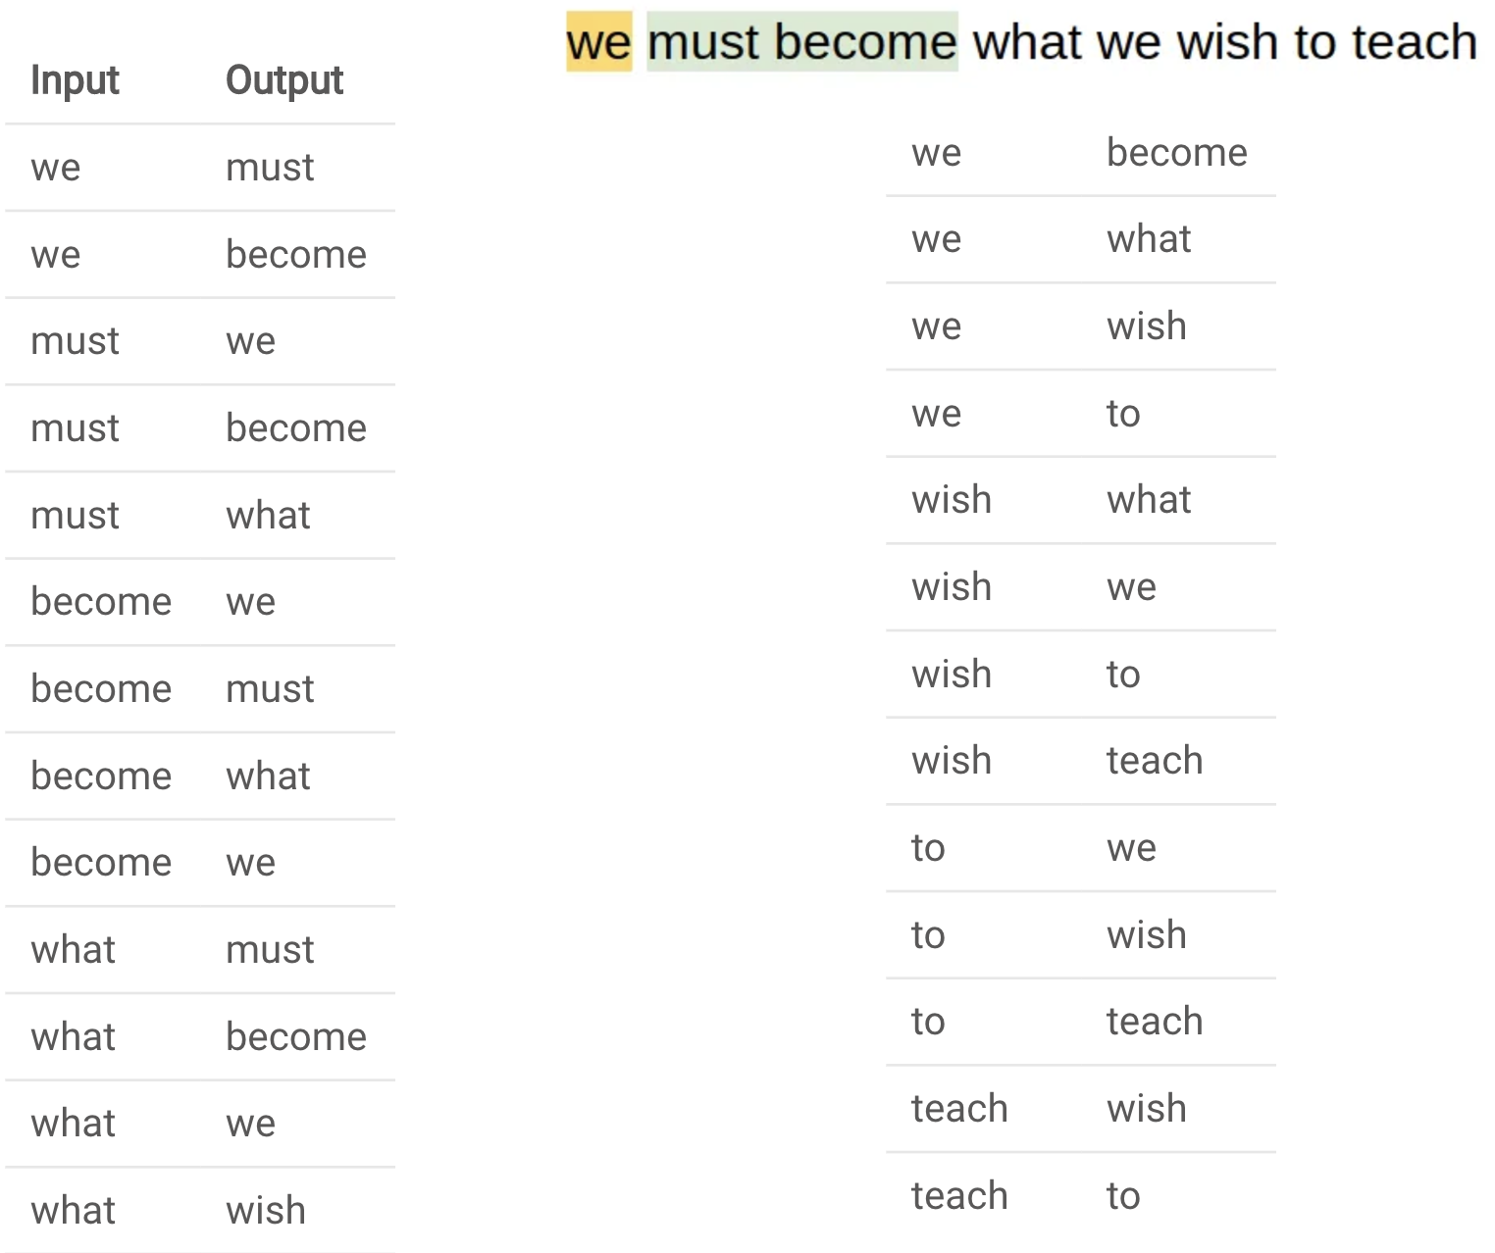
Word2Vec Revisited

Slide 37
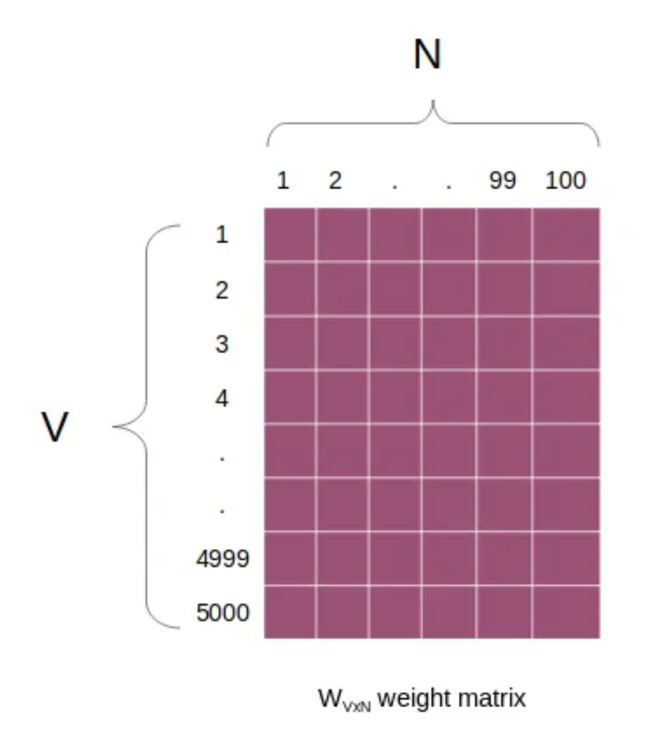
Weight Matrix (V x N)

Slide 38
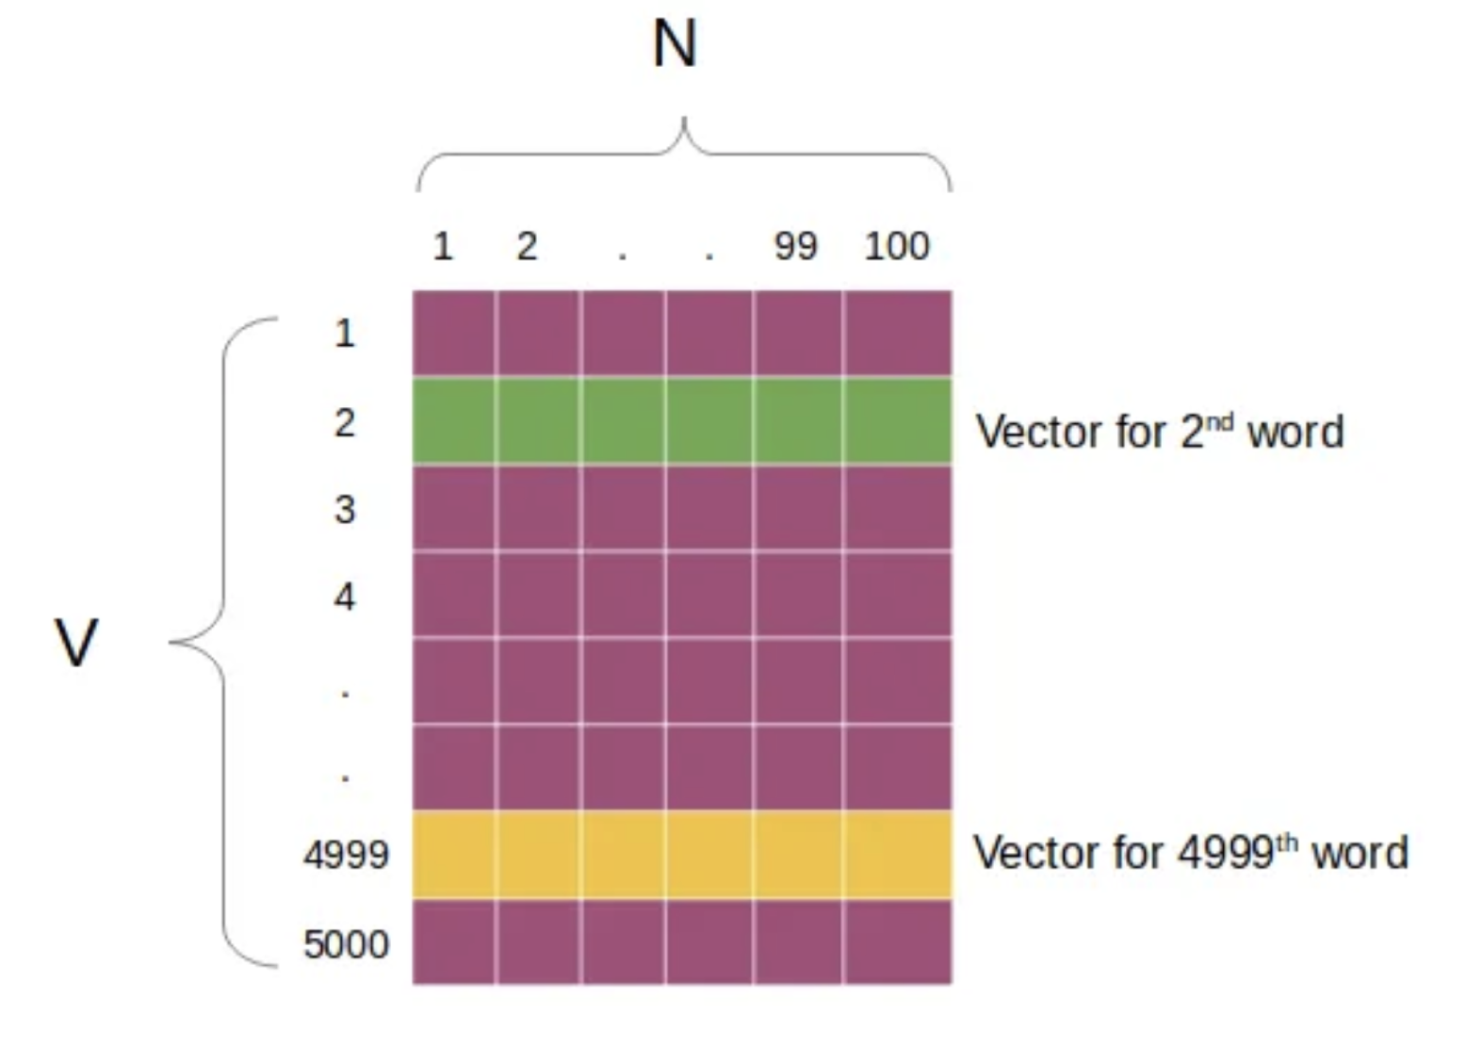
Weight Matrix (V x N)

Slide 39
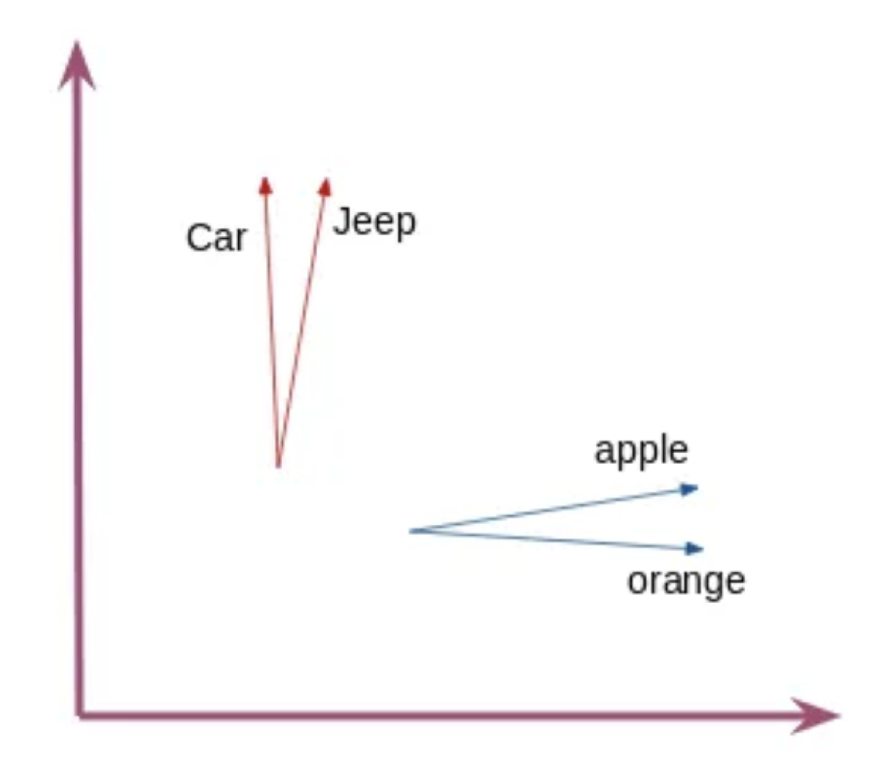
Word Vectors Cosine Similarity

Slide 40
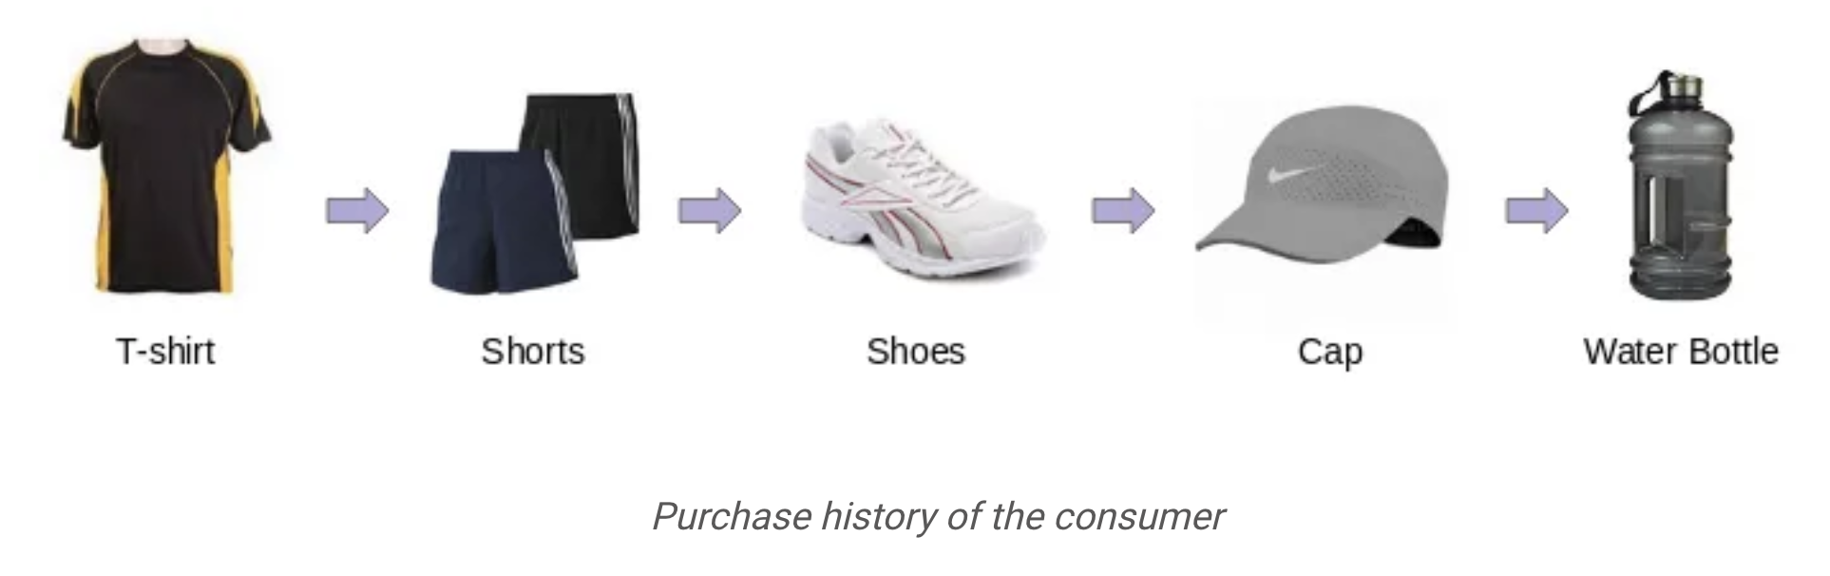
Problem: Product Recommendation

Slide 41
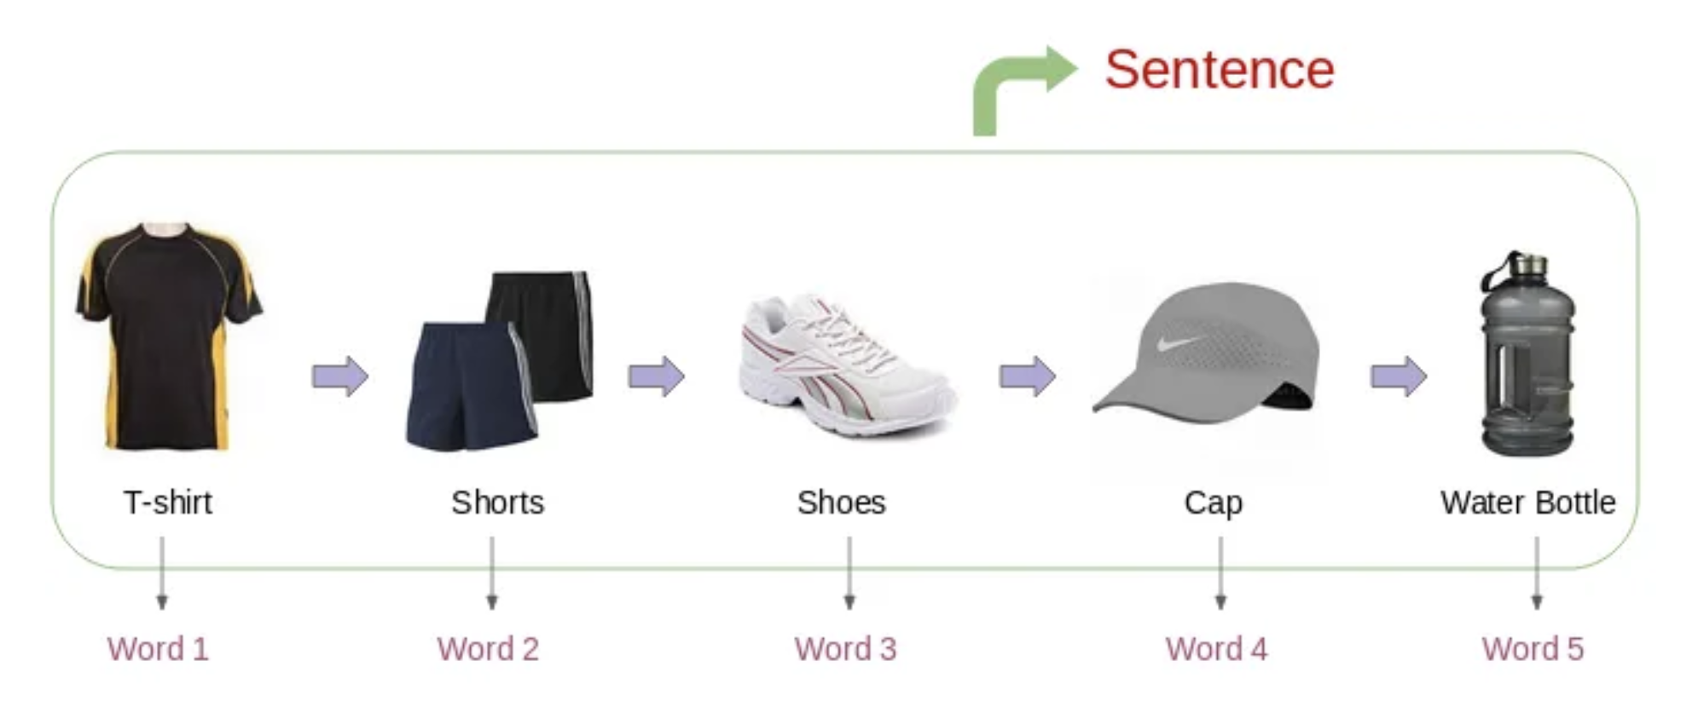
Word2Vec Recommendation

Slide 42
Dataset
https://archive.ics.uci.edu/ml/machine-learning-databases/00352/
Simple_Recommendation_System.ipynb

Slide 43
Evaluation Metrics
Recall
Precision
RMSE
Mean Reciprocal Rank
Mean Average Precision
Normalized Discounted Cumulative Gain

Slide 44
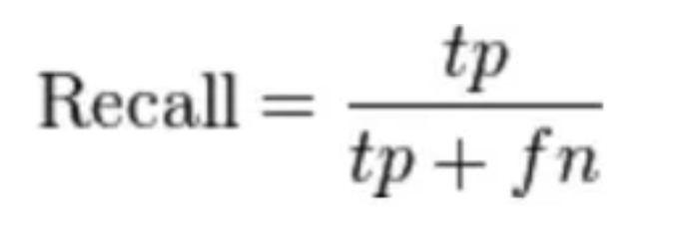
Recall
What proportion of items that a user likes were actually recommended
• Here tp represents the number of items recommended to a user that he/she likes and tp+fn represents the total items that a user likes
• If a user likes 5 items and the recommendation engine decided to show 3 of them, then the recall will be 0.6
• Larger the recall, better are the recommendations

Slide 45
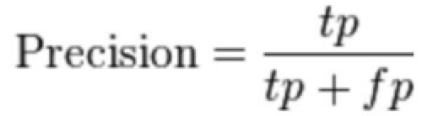
Precision
Out of all the recommended items, how many did the user actually like?
◦ Here tp represents the number of items recommended to a user that he/she likes and tp+fp represents the total items recommended to a user
◦ If 5 items were recommended to the user out of which he liked 4, then precision will be 0.8
◦ Larger the precision, better the recommendations
◦ But consider this case: If we simply recommend all the items, they will definitely cover the items which the user likes. So we have 100% recall! But think about precision for a second. If we recommend say 1000 items and user likes only 10 of them, then precision is 0.1%. This is really low. So, our aim should be to maximize both precision and recall.

Slide 46
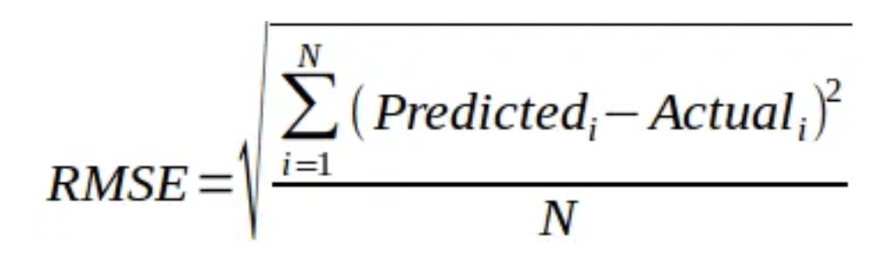
Root Mean Square Error
It measures the error in the predicted ratings
• Here, Predicted is the rating predicted by model and Actual is original rating
• If a user has given a rating of 5 to a movie and we predicted the rating as 4, then RMSE is 1
• Lesser the RMSE value, better the recommendations
Drawback: No ordering of products recommended is maintained

Slide 47
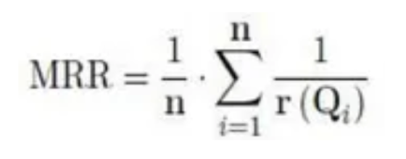
Mean Reciprocal Rank
Evaluates the list of recommendations
• Suppose we have recommended 3 movies to a user, say A, B, C in the given order, but the user only liked movie C. As the rank of movie C is 3, the reciprocal rank will be 1/3
• Larger the mean reciprocal rank, better the recommendations

Slide 48
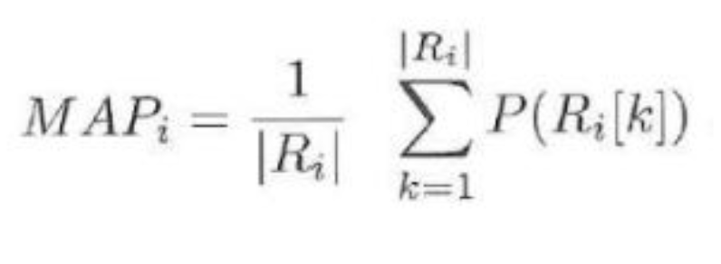
Mean Average Precision
Precision and Recall don’t care about ordering in the recommendations
• Precision at cutoff k is the precision calculated by considering only the subset of your recommendations from rank 1 through k
• Suppose we have made three recommendations [0, 1, 1]. Here 0 means the recommendation is not correct while 1 means that the recommendation is correct. Then the precision at k will be [0, 1/2, 2/3], and the average precision will be (1/3)*(0+1/2+2/3) = 0.38
• Larger the mean average precision, more correct recommendations

Slide 49
Exercise: Build a Text Recommender System

Slide 50
Building a Text Recommender
Create a Text Recommender
Dataset: MovieLens 20M dataset
Note: Please use Kaggle Kernel or Google Colab or Your own local GPU machine for this task. It will take days to complete if you use CPU :)

Slide 51
Further Reading
Practical Natural Language Processing
Soumya Vajjala, Anuj Gupta, Harshit Surana, Bodhisattwa Majumder

